Slide 1
MATH221
Mathematics for Computer Science
Unit 4
Set Theory

Slide 2
OBJECTIVES
Understand the basic terminologies and concepts in set theory.
Understand and apply the set operations.
Simplifying set expressions
Proving results that involve expressions on sets.

Slide 3
Set
A set is a collection of elements (objects).For example, {0, 1, -1} is a set.
The order in which the elements are listed is irrelevant; and no repetition of the same element in a set. For example, no difference between the following two sets (there are the same - equal):
{0, 1, -1}, {-1, 0, 1}
We will usually use small letters for elements and capital letters for sets.

Slide 4
Basic Concept and Notation
1. x ∈ A is read “x is an element of A”.
2. x ∉ A is read “x is not an element of A”.
3. {x: x ∈ B ∧ P(x)} is read “the set of all elements of B which make the statement P(x) true”.
More often, this notation is more simply written {x ∈ B: P(x)}.
This is called set builder notation.

Slide 5

Examples
(i) {x: x ∈ ℝ ∧ 0 ≤ x ≤ 1}
= {x ∈ ℝ: 0 ≤ x ≤ 1}
= [0, 1] (interval notation in Calculus)
The set of all rational numbers, ℚ can be written as
ℚ = { : a, b ∈ ℤ ∧ b ≠ 0}.
(iii) {x ∈ ℝ: x³ = x} = {0, 1, -1}
$$\frac{a}{b}$$

Slide 6
A Special Set: Empty Set
The empty set (or null set), denoted by ∅, is described as the set having no elements.
Some books express as ∅ = {}.

Slide 7
Example:
Write down the elements in each of the following sets.
(i) {x ∈ ℕ: x³ = x}
= {1}
(ii) {x ∈ ℝ: x² = 9}
= {-3, 3}
(iii) {x ∈ ℤ: x³ = 7}
= ∅

Slide 8
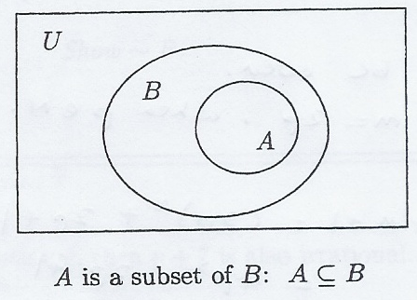
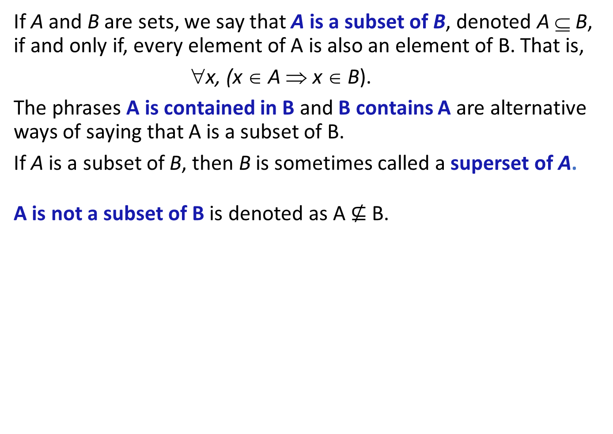
Subsets
If A and B are sets, we say that A is a subset of B, denoted A ⊆ B, if and only if, every element of A is also an element of B. That is,
A ∀x, (x ∈ A ⇒ x ∈ B).
The phrases A is contained in B and B contains A are alternative ways of saying that A is a subset of B.
If A is a subset of B, then B is sometimes called a superset of A.
A is not a subset of B is denoted as A $⊈$ B.

Slide 9
Subsets: Notes
If A and B are sets, how to prove ~ (A ⊆ B)?
Since ~ (∀x, (x ∈ A ⇒ x ∈ B)) ≡ ∃x, ~ (x ∈ A ⇒ x ∈ B)
≡ ∃x, ~ (~ (x ∈ A) ∨ (x ∈ B))
≡ ∃x, (x ∈ A ∧ ~ (x ∈ B))
≡ ∃x, (x ∈ A ∧ x ∉ B).
Hence, to to prove ~ (A ⊆ B), we need to prove ∃x, (x ∈ A ∧ x ∉ B).

Slide 10
Discussion:
Decide whether the following are true or false.
(i) {1, 2} ⊆ {1, 2, 3}
True
(ii) {0, 2} ⊆ {1, 2, 3}
False
(iii) {1} is the same as 1.
False

Slide 11
Discussion:
(iv) 1 ∈ {x ∈ ℕ: x² =1}
True
(v) {1} ∈ {x ∈ ℕ: x² =1}
False
(vi) Let A be any set. Then ∅ ⊆ A.
True

Slide 12
Singleton Sets
Sets having a single element are frequently called singleton sets.
Example: {1} is a singleton set.

Slide 13
Universal Set
Most mathematical discussions are carried on within some context.
For example, in a certain situation, all sets being considered might be sets of real numbers. In such a situation, the set of real numbers would be called a universal set for the discussion.

Slide 14
Exercise: Subsets
Let A be a set. Prove that ∅ ⊆ A.
Proof:
  Suppose ~ (∅ ⊆ A).
  Then, there exists y ∈ ∅ such that y ∉ A.
  This, therefore, means that ∅ is not empty, which is contradiction.
  Therefore, ∅ ⊆ A.

Slide 15
Subset: Note
We have the following relationship between sets we met earlier.
∅ ⊆ ℕ ⊆ ℤ ⊆ ℚ ⊆ ℝ

Slide 16
Examples:
Let S be a set. Determine whether the following are true or false.
(i) S ∈ S
False
(ii) S ⊆ {S}
False
(iii) ∅ ⊆ {S}
True

Slide 17
Examples:
(iv) ∅ ∈ {S}
False
(v) {∅} ⊆ {S}
False

Slide 18

Proper Subset
If A and B are sets, we say that A is a proper subset of B if
A ⊆ B but B $⊈$A.
This is usually denoted by A ⊂ B.
A is not a proper subset of B is denoted as A ⊄ B.

Slide 19
Proper Subset: Note
If A is a proper subset of B, there must be at least one element in B that is not in A.

Slide 20
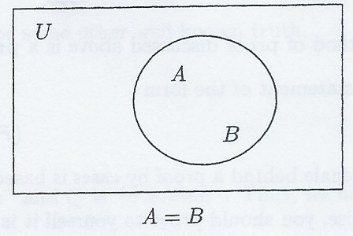
Set Equality
If A and B are sets, we will say that A = B if
A ⊆ B and B ⊆ A.
Hence, to prove that two sets are equal from the definition, we must show two things:
(i) A ⊆ B and (ii) B ⊆ A.
A = B if and only if every element of A is an element of B and every element of B is an element of A.

Slide 21
Notation: Note
Technically, the listing of elements can be done only for finite sets. For example, W = {1, 2, 3, 4}.
However, if an infinite set is defined by a “simple” rule, we sometimes write a few elements and then use “…” to mean roughly “and so on” or “by the same rule”.

Slide 22
Notation: Example
(i) ℕ = {1, 2, 3, 4, …}.
(ii) If we want the set of all even integers, we have a few options.
E = {n ∈ ℤ: n is even}
E = {…, -4, -2, 0, 2, 4, …}
E = {n ∈ ℤ: ∃p ∈ ℤ, n = 2p}.
Note:
Can we list the elements in ℚ as we did in the last example? What about for ℝ? (that is, specify directly)
  No

Slide 23
Notation: Note
If a ∈ U, then {x ∈ U: x = a} = {a}.
The set {a} is NOT the same as a.
The former is a SET containing the ELEMENT a.
The latter is an element a.

Slide 24
Power Sets
Given a set A, the power set of A , denoted by P(A), is the set of all subsets of A.

Slide 25
Power Sets: Example
Find the power set of the set {x, y}. That is find P({x, y}).
P({x, y}) = {∅, {x}, {y}, {x, y}}.

Slide 26

Operations on Sets (Set Operations)
There are four main operations on sets, one corresponding to each of the logical connectives.
  Set Operation Name
  Complement
  ∪ Union
∩ Intersection
− difference
$$\overline{A}$$

Slide 27
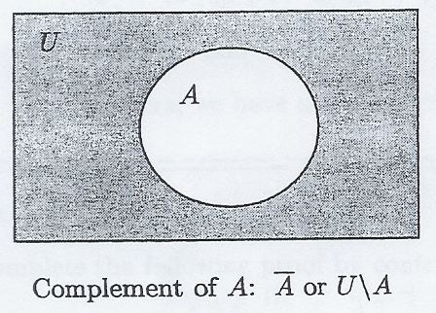



Complements
Let U be a universal set, and let A ⊆ U.
Then the complement of A, denoted by or U \ A, is given by
= {x ∈ U: ~ (x ∈ A)} = {x ∈ U: x ∉ A}.
$$\overline{A}$$
$$\overline{A}$$
Complement of A is the set that contains elements in U not belonging to A.
A′ and A^{c} are also used to denote in some books.
$$\overline{A}$$

Slide 28



Examples:
$$\overline{A}$$
Let U = ℤ. Write down for the following sets.
(i) A = {x ∈ ℤ: x is even}
= {x ∈ ℤ: ~ (x is even)} = {x ∈ ℤ: x is odd}
A = {x ∈ ℤ: x > 0 ∨ x < 0}
= {x ∈ ℤ: ~ (x > 0 ∨ x < 0)} = {x ∈ ℤ: x = 0} = {0}
$$\overline{A}$$
$$\overline{A}$$

Slide 29
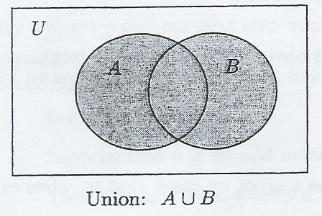
Union
Let A and B be subsets of a universal set U.
Then the union of A and B, denoted by A ∪ B, is defined as:
A ∪ B = {x ∈ U: x ∈ A ∨ x ∈ B}.
A∪B is the set that contains all the elements belonging to A or B or both
Alternatively, A∪B can also be defined as:
    A ∪ B = {x: x ∈ A ∨ x ∈ B}
without referencing to U.

Slide 30
Example:
Let U = ℝ. Write down A ∪ B for the following sets.
(i) A = {1} and B = {2}
A ∪ B = {1, 2}
(ii) A is the set of all even integers, B is the set of all odd integers.
A ∪ B = {x ∈ ℝ: x ∈ ℤ} = ℤ
(iii) A = {x ∈ ℝ: 0 ≤ x ≤ 2} and B = {x ∈ ℝ: 1 ≤ x ≤ 3}
A ∪ B = {x ∈ ℝ: 0 ≤ x ≤ 3}
  (refer to the note on analyzing intervals in the Appendix)

Slide 31
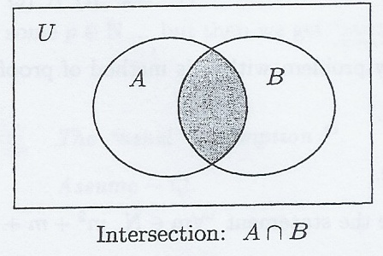
Intersection
Let A and B be subsets of a universe U.
Then the intersection of A and B, denoted by A ∩ B, is defined as:
A ∩ B = {x ∈ U: x ∈ A ∧ x ∈ B}.
A∩B is the set that contains all the elements belonging both A and B.
Alternatively, A ∩ B can also be defined as:
    A ∩ B = {x: x ∈ A∧ x ∈ B}
without referencing to U.

Slide 32
Example:
Let U = ℝ. Write down A ∩ B for the following sets.
(i) A = {1, 2, 3, 5} and B = {1, 4, 5, 6}
A ∩ B = {1, 5}
(ii) A is the set of all even integers, B is the set of all odd integers.
A ∩ B = ∅
(iii) A = {x ∈ ℝ: 0 ≤ x ≤ 2} and B = {x ∈ ℝ: 1 ≤ x ≤ 3}
A ∩ B = {x ∈ ℝ: 1 ≤ x ≤ 2}
(refer to the note on analyzing intervals in the Appendix)

Slide 33
Difference
Let A and B be subsets of a universal set U.
Then the difference of A minus B, denoted by A – B or A\B, is given by
A - B = {x ∈ U: x ∈ A ∧ x ∉ B}.
Alternatively, A - B can also be defined as:
  A - B = {x: x ∈ A ∧ x ∉ B}.
without referencing to U.

Slide 34



Difference: Notes
1. The difference of A – B is sometimes called the relative complement of B in A.
2. Since A ⊆ U and B ⊆ U, A - B ⊆ U.
3. If we let A = U, then we have
A - B = {x ∈ A: x ∈ A ∧ x ∉ B}
= {x ∈ U: x ∉ B}
=
$$\overline{B}$$
4. Using Definitions, we can simplify the definition of – as follows:
A - B = {x ∈ U: x ∈ A ∧ x ∉ B}
= {x ∈ U: x ∈ A ∧ x ∈ }
= A ∩
$$\overline{B}$$
$$\overline{B}$$

Slide 35
Disjoint Sets
Let A and B be sets.
Then A and B are said to be disjoint if
A ∩ B = ∅.
That is, disjoint sets have no elements in common.

Slide 36
Example:
Let U = ℝ, A = {1, 2, 3} and B = {2}, C = {2, 3, 4} and
D = [0, 1] = {x ∈ ℝ: 0 ≤ x ≤ 1}.
(i) Write down
(a) A - C
= {1}
(b) B - C
= ∅
(c) D - B
= {x ∈ ℝ: 0 ≤ x ≤ 1}

Slide 37
Example:
Let U = ℝ, A = {1, 2, 3} and B = {2}, C = {2, 3, 4} and
D = [0, 1] = {x ∈ ℝ: 0 ≤ x ≤ 1}.
(i) (a) D - A
= [0, 1) = {x ∈ ℝ: 0 ≤ x < 1}
(b) A - D
= {2, 3}
(ii) Which pairs of sets from A, B, C, D are disjoint?
B and D, C and D.

Slide 38
Theorem – Basic Properties in Set Theory
Algebra Of Sets
A list of rules governing set theory, and the relationships between various sets and set expressions. We can prove these using the definitions we have learnt so far.
Let U be a universal set and let A, B, and C be elements of P(U).
1. (A ⊆ B ∧ B ⊆ C) ⇒ A ⊆ C
A ⊆ A ∪ B
A ∩ B ⊆ A
2. A = B ⇔ (A ⊆ B ∧ B ⊆ A)
A ⊆ B ⇔ A ∪ B = B
A ⊆ B ⇔ A ∩ B = A

Slide 39
Theorem – Basic Properties in Set Theory
3. A ⊆ B ⇒ A ∪ C ⊆ B ∪ C
A ⊆ B ⇒ A ∩ C ⊆ B ∩ C
4. Commutative Laws:
A ∪ B = B ∪ A
A ∩ B = B ∩ A
5. Associative Laws:
(A ∪ B) ∪ C = A ∪ (B ∪ C)
(A ∩ B) ∩ C = A ∩ (B ∩ C)

Slide 40
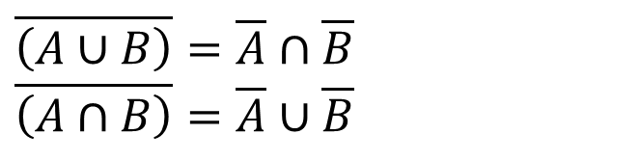
Theorem – Basic Properties in Set Theory
6. Distributive Laws:
A ∪ (B ∩ C) = (A ∪ B) ∩ (A ∪ C)
A ∩ (B ∪ C) = (A ∩ B) ∪ (A ∩ C)
7. DeMorgan’s Laws:
$$\overline{\left(A∪B\right)}=\overline{A}∩\overline{B} \\ \overline{\left(A∩B\right)}=\overline{A}∪\overline{B}$$

Slide 41

Corollary
Let U be a universal set and let A, B, and C be elements of P(U).
1. Facts about Complementation:
$$\overline{\left(\overline{A}\right)}=A \\ A⊆B⇔\overline{B}⊆\overline{A} \\ A−B=A∩\overline{B} \\ \overline{U}=∅ \\ \overline{∅}=U$$
Double Complement Laws
Set Difference Law

Slide 42

Corollary
2. Properties of ∅ and U:
3. Subset properties of ∪ and ∩:
(A ⊆ C ∧ B ⊆ C) ⇔ (A ∪ B) ⊆ C
(A ⊆ B ∧ A ⊆ C) ⇔ A ⊆ (B ∩ C)
$$A∩U=A A∪∅=A \\ A∩∅=∅ A∪U=U \\ A∩\overline{A}=∅ A∪\overline{A}=U$$
Identity Laws
Universal Bound Laws
Complement Laws

Slide 43
Corollary
4. Idempotent Laws:
A ∪ A = A
A ∩ A = A
5. Absorption Laws:
A ∪ (A ∩ B) = A
A ∩ (A ∪ B) = A

Slide 44
Proving Results on Sets
We can use any suitable method of proof discussed in Unit 3 to prove results on sets from the definitions or from the basic properties discussed earlier.
The first method is called typical “element argument” method. The framework for proving A ⊆ B is as follows:
  From definition, to prove that A ⊆ B, we must show that
  ∀x, (x ∈ A ⇒ x ∈ B).
  We begin by letting x ∈ A, that is, we take x to be an arbitrary element of A.
  Finally, we must prove that x ∈ B.

Slide 45
Proving Results on Sets
The method discussed in the previous example can be used to prove set equalities by using the definition
A = B ⇔ (A ⊆ B ∧ B ⊆ A)
then showing A ⊆ B ∧ B ⊆ A using the method twice.
Using this definition to prove is sometimes called a “double containment” proof.

Slide 46
Proving Results on Sets: Example 1
Let U be a set and let A, B and C be elements of P(U). Prove that A ⊆ A ∪ B.
We must prove x ∈ A ⇒ x ∈ A ∪ B.
Forward: Let x ∈ A. (This means we “know” x ∈ A)
Backward: By definition, x ∈ A ∨ x ∈ B ⇒ x ∈ A ∪ B.
To complete the proof, we need the step x ∈ A ⇒ x ∈ A ∨ x ∈ B. However, in terms of logic, we note that P ⇒ (P ∨ Q) is a tautology.

Slide 47
Proving Results on Sets: Example 1
Proof:
  Let x ∈ A. Then we have
x ∈ A ⇒ x ∈ A ∨ x ∈ B
⇒ x ∈ A ∪ B.
Therefore, A ⊆ A ∪ B.

Slide 48
Proving Results on Sets: Example 2
Prove the statement A ⊆ B ⇔ A ∪ B = B.
The proof is in two parts:
(1) A ⊆ B ⇒ A ∪ B = B
(2) A ∪ B = B ⇒ A ⊆ B
To prove part (1), let A ⊆ B. We must show that A ∪ B = B. To do this, we must prove two things
(i) A ∪ B ⊆ B
(ii) B ⊆ A ∪ B

Slide 49
Proving Results on Sets: Example 2
To prove part (i), i.e. A ∪ B ⊆ B:
Let x ∈ A ∪ B, then by definition, x ∈ A ∨ x ∈ B.
To complete this part of the proof, we have to prove that
x ∈ A ∨ x ∈ B ⇒ x ∈ B. This requires a proof by cases.
Case 1: If x ∈ B, there is nothing to show.
Case 2: If x ∈ A, we know that A ⊆ B,
and so x ∈ B.
Therefore, we have established that
x ∈ A ∪ B ⇒ (x ∈ A ∨ x ∈ B) ⇒ x ∈ B
Thus A ∪ B ⊆ B.

Slide 50
Proving Results on Sets: Example 2
To prove part (ii), i.e. B ⊆ A ∪ B:
Let x ∈ B, then we have
x ∈ B ⇒ x ∈ A ∨ x ∈ B.
⇒ x ∈ A ∪ B
Therefore, B ⊆ A ∪ B.
Therefore, we have proven that A ⊆ B ⇒ A ∪ B = B.

Slide 51
Proving Results on Sets: Example 2
To prove part (2), let A ∪ B = B. We must show that A ⊆ B.
Let x ∈ A. Then we have
x ∈ A ⇒ x ∈ A ∨ x ∈ B.
⇒ x ∈ A ∪ B (By definition)
⇒ x ∈ B (as A ∪ B = B)
Therefore, A ⊆ B.
Therefore, we have proven that A ∪ B = B ⇒ A ⊆ B.
Therefore, A ⊆ B ⇔ A ∪ B = B.

Slide 52
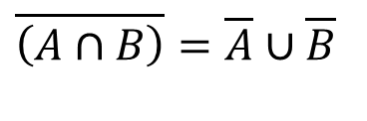
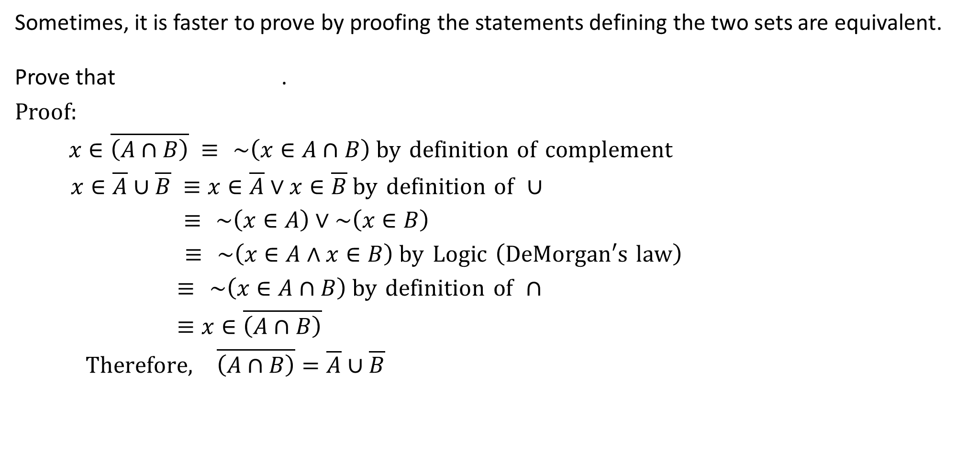
Proving Results on Sets: Example 3
Sometimes, it is faster to prove by proofing the statements defining the two sets are equivalent.
Prove that .
Proof:
$x∈\overline{\left(A∩B\right)} ≡ \sim \left(x∈A∩B\right) \text{by} \text{definition} \text{of} \text{complement}$
$x∈\overline{A}∪\overline{B} ≡x∈\overline{A}∨x∈\overline{B} \text{by} \text{definition} \text{of} ∪$
$≡ \sim \left(x∈A\right)∨\sim \left(x∈B\right)$
$≡ \sim \left(x∈A∧x∈B\right) \text{by} \text{Logic} \left(\text{DeMorgan}\text{′}\text{s} \text{law}\right)$
$≡ \sim \left(x∈A∩B\right) \text{by} \text{definition} \text{of} ∩$
$≡x∈\overline{\left(A∩B\right)}$
$\text{Therefore}\text{,} \overline{\left(A∩B\right)}=\overline{A}∪\overline{B}$
$$\overline{\left(A∩B\right)}=\overline{A}∪\overline{B}$$

Slide 53


Proving Results on Sets: Note
Some results can be proved using properties from the theorem step-by-step method.
Example.
Using (i) A ⊆ B ⇔ A ∪ B = B
(ii) A ⊆ B ⇔ A ∩ B = A
(iii)
Prove that .
$$\overline{\left(A∩B\right)}=\overline{A}∪\overline{B}$$
$$A⊆B⇔\overline{B}⊆\overline{A}$$

Slide 54


Proving Results on Sets: Note
Proof:
$$A⊆B ⇔A∩B=A \text{by} \text{part} \left(\text{ii}\right)$$
$⇔\overline{A∩B}=\overline{A}$
$⇔\overline{A}∪\overline{B}=\overline{A} \text{by} \text{part} (\text{iii}$)
$⇔\overline{B}∪\overline{A}=\overline{A}$
$$⇔\overline{B}⊆\overline{A} \text{by} \text{part} (i)$$

Slide 55
Example:
(ii) Disprove that A – (B – C) = (A – B) – C.
Consider the following sets:
A = {1, 2, 3}, B = {3}, C = {2, 3}
A – (B – C) = {1, 2, 3} – ({3} - {2, 3})
= {1, 2, 3}
(A – B) – C = ({1, 2, 3} – {3}) - {2, 3}
= {1, 2} - {2, 3}
= {1}
Therefore, A – (B – C) ≠ (A – B) – C.

Slide 56
Appendix: Note on Analyzing Intervals
Exercise on Union:
A = {x ∈ ℝ: 0 ≤ x ≤ 2} and B = {x ∈ ℝ: 1 ≤ x ≤ 3}
A ∪ B = {x ∈ ℝ: 0 ≤ x ≤ 3}
Exercise on Intersection:
A = {x ∈ ℝ: 0 ≤ x ≤ 2} and B = {x ∈ ℝ: 1 ≤ x ≤ 3}
A ∩ B = {x ∈ ℝ: 1 ≤ x ≤ 2}
0
1
2
3
0
1
2
3

Slide 57
End of Unit 4

